Slide 1
Public Health Analytics & Predictive Modeling
Data-Driven Regional Health Risk Profiling & Outbreak Forecasting
Presented By: Parvathy S Nair
2nd Semester, MSC Data Science with Big Data Analytics
Notes:
SPEAKER NOTES & PRESENTATION SCRIPT:
Good morning respected members of the evaluation committee. Today, I am presenting my project, 'Public Health Analytics & Predictive Modeling'. In this project, I have built an analytical and predictive pipeline using Python to inspect historical healthcare records across eight Indian states over a four-year period. By investigating spatial, seasonal, and environmental parameters, I formulated a composite Health Vulnerability Index, clustered regional risks using K-Means, and trained a Random Forest model to predict disease caseloads with high accuracy. Let us move to the abstract.

Slide 2
Abstract
Background:
Epidemiological surveillance relies heavily on identifying multi-dimensional triggers. This study implements an analytical pipeline to profile regional health risks and forecast outbreak surges.
Methodology:
- Dataset: 4-year panel data (384 records) across 8 Indian states.
- Mathematical Modeling: Engineered a composite Health Vulnerability Index (HVI).
- Unsupervised Learning: Applied K-Means clustering ($K=3$) for risk segmentation.
Key Findings:
- Correlations: Vaccination Rate exhibits a strong negative correlation (-0.81) with cases, while AQI shows a strong positive correlation (+0.68).
- Vulnerability: Delhi and West Bengal exhibit the highest average HVI, while Kerala and Tamil Nadu are the most resilient.
- Supervised Forecasting: RandomForest Regressor predicts disease cases with 95.7% accuracy ($R^2$: 0.957, MAE: 120.30 cases).
Public Health Analytics & Predictive Modeling | External Project Review
Slide 2 of 19
Notes:
SPEAKER NOTES & PRESENTATION SCRIPT:
This slide presents the abstract of the project. It summarizes the entire study: our context, methodology, and key results. We analyze a panel of 384 records across 8 Indian states. Our key finding is that vaccination acts as a strong protective shield while AQI increases outbreaks. The HVI index ranks regional vulnerabilities, K-Means clusters risk levels, and the Random Forest model achieves a high predictive score of 95.7% accuracy.

Slide 3
Project Objectives
Primary Goal: Build an end-to-end analytical framework to monitor, index, and forecast public health outbreaks using environmental and healthcare metrics.
Specific Objectives:
1. Identify Correlations: Map quantitative relationships between air quality, vaccinations, infrastructure, and disease cases.
2. Seasonal Trends: Model monthly and seasonal variations in transmission.
3. Geographic Distribution: Identify high-burden hot spots across 8 Indian states.
4. Immunization Efficacy: Quantify the real-world protective impact of vaccination campaigns.
5. Composite Indexing: Formulate a Health Vulnerability Index (HVI) to rank and prioritize states.
6. Risk Segmentation: Group region-months into clusters for targeted interventions.
7. Predictive Modeling: Train a machine learning regressor to forecast disease cases.
Analytical Key Layers:• Exploratory Analytics: Statistical correlations and seasonal trends.
• Mathematical Modeling: Composite Health Vulnerability Index.
• Unsupervised ML: Risk segmentation using K-Means Clustering.
• Supervised ML: Predictive Random Forest outbreak regressor.
Public Health Analytics & Predictive Modeling | External Project Review
Slide 3 of 19
Notes:
SPEAKER NOTES & PRESENTATION SCRIPT:
Our presentation is structured around achieving these seven core objectives. We begin with general exploratory correlation analysis, proceed to temporal and geographic trends, construct our customized Health Vulnerability Index, execute unsupervised risk clustering using K-Means, and finally train a predictive Random Forest model to warn health departments of upcoming surges.

Slide 4
System Requirements Specification
Software Requirements:
- Operating System: Windows 10/11, macOS, or Linux.
- Programming Language: Python 3.8+ (current environment uses Python 3.12).
- Core Libraries (Data Science Stack):
- `pandas` (version 2.0+) & `numpy` - Data ingestion, profiling, and index engineering.
- `scikit-learn` - Machine learning modeling (KMeans & RandomForest).
- `matplotlib` & `seaborn` - Visual chart generation.
- `python-pptx` - Programmatic PowerPoint construction.
Hardware Requirements:
- Processor (CPU): Dual-Core 2.0 GHz or higher (Minimum); Intel Core i5 / AMD Ryzen 5 or higher (Recommended for fast Random Forest execution).
- Memory (RAM): 4 GB RAM (Minimum); 8 GB RAM or higher (Recommended to support concurrent ML training and plotting in memory).
- Storage: 500 MB of free hard drive space (for Python environment installation, historical datasets, visual PNG figures, and generated presentations).
Public Health Analytics & Predictive Modeling | External Project Review
Slide 4 of 19
Notes:
SPEAKER NOTES & PRESENTATION SCRIPT:
To run this data pipeline and reproduce our analytics, specific software and hardware setups are required. For software, we use Python 3.8 or above along with the standard data science libraries: pandas, numpy, scikit-learn for models, matplotlib and seaborn for visualization, and python-pptx for building this deck. Hardware requirements are minimal: any standard system with at least 4 gigabytes of RAM and 500 megabytes of disk space is sufficient to execute the pipeline in seconds.

Slide 5
Dataset Profile & Data Preprocessing
Dataset Dimensions:
- Total Records: 384 monthly records.
- Duration: 4 Years (2022 to 2025).
- Spatial Scope: 8 Indian states represented.
Dataset Schema Features:
- Demographics: State name, Population.
- Epidemiology: Disease Cases, Mortality Rate.
- Immunization: Vaccination Rate (%).
- Resources: Hospital Beds, Doctors count.
- Environment: Air Quality Index (AQI).
Data Preprocessing Pipeline:
- Missing Values: Checked for nulls across all features; dataset is 100% complete.
- Deduplication: Verified row uniqueness; zero duplicates detected.
Descriptive Statistics:
- Average Disease Cases: 2,423.86 cases per state-month.
- Average Vaccination Rate: 64.95%.
- Average Mortality Rate: 1.80%.
- Average Air Quality Index: 142.49 (Moderate to Poor quality range).
Public Health Analytics & Predictive Modeling | External Project Review
Slide 5 of 19
Notes:
SPEAKER NOTES & PRESENTATION SCRIPT:
Before building our models, we audited the data profile. The dataset is a balanced panel containing 384 state-month observations from 2022 to 2025. It covers 10 features. Data cleaning showed that the records contain no null elements or duplicate rows, ensuring robust inputs. On average, we observe about 2,424 cases per state-month, a 64.95% vaccination rate, and an average AQI of 142.49.

Slide 6
Database Design: Entity-Relationship (ER) Diagram
tbl_States
tbl_Metrics
Database Normalization:
- To ensure data integrity and avoid redundancy, the flat CSV structure is mapped to a normalized relational schema.
Entity Details:
- tbl_States: Stores static regional properties (Name, Population).
- tbl_Metrics: Stores time-series monthly environmental, medical resource, and epidemiologic data.
Relationship Logic:
- 1-to-Many Relationship: One state in `tbl_States` maps to multiple monthly records in `tbl_Metrics` (joined on `State_ID`).
State_ID (PK) [INT]
State_Name [VARCHAR]
Population [BIGINT]
1
N (∞)
Record_ID (PK) [INT]
State_ID (FK) [INT]
Year [INT]
Month [INT]
Disease_Cases [INT]
Vaccination_Rate [FLOAT]
Hospital_Beds [INT]
Doctors [INT]
Mortality_Rate [FLOAT]
Air_Quality_Index [INT]
Public Health Analytics & Predictive Modeling | External Project Review
Slide 6 of 19
Notes:
SPEAKER NOTES & PRESENTATION SCRIPT:
For database design, we mapped the flat dataset into a normalized relational schema to avoid redundancy. We have two entities: tbl_States which holds the state attributes, and tbl_Metrics which stores the monthly time-series health and air quality records. There is a one-to-many relationship between States and Metrics because each state has multiple monthly records over the four-year study period.

Slide 7
Health Vulnerability Index (HVI) Formulation
Why Develop HVI?
- Raw disease case counts fail to represent infrastructure preparedness or medical severity.
- HVI aggregates disease burden, mortality risk, community susceptibility, and resource shortages into a single, standardized index.
Index Range:
- Ranges strictly from 0.0 (most resilient/healthiest) to 1.0 (most vulnerable/critical risk).
HVI Formula & Weighting Logic:
HVI = (Cases / Max_Cases) * 0.4
+ (Mortality / Max_Mortality) * 0.3
+ (1 - Vaccination / 100) * 0.2
+ (1 - Beds / Max_Beds) * 0.1
Rationale behind Weights:
- Active Case Load (40%): Outbreak scale is the primary risk driver.
- Mortality Rate (30%): Represents clinical severity.
- Susceptibility (20%): Represents unvaccinated population scale.
- Resource Shortage (10%): Reflects lack of beds.
Public Health Analytics & Predictive Modeling | External Project Review
Slide 7 of 19
Notes:
SPEAKER NOTES & PRESENTATION SCRIPT:
A key contribution of this project is the Health Vulnerability Index (HVI). Instead of analyzing variables in isolation, we designed an HVI metric using a weighted scoring model. It assigns 40% weight to scaled active cases, 30% to scaled mortality, 20% to the unvaccinated percentage, and 10% to the bed deficit. This index gives public health administrators a simple, data-backed value between 0 and 1 to compare states.

Slide 8
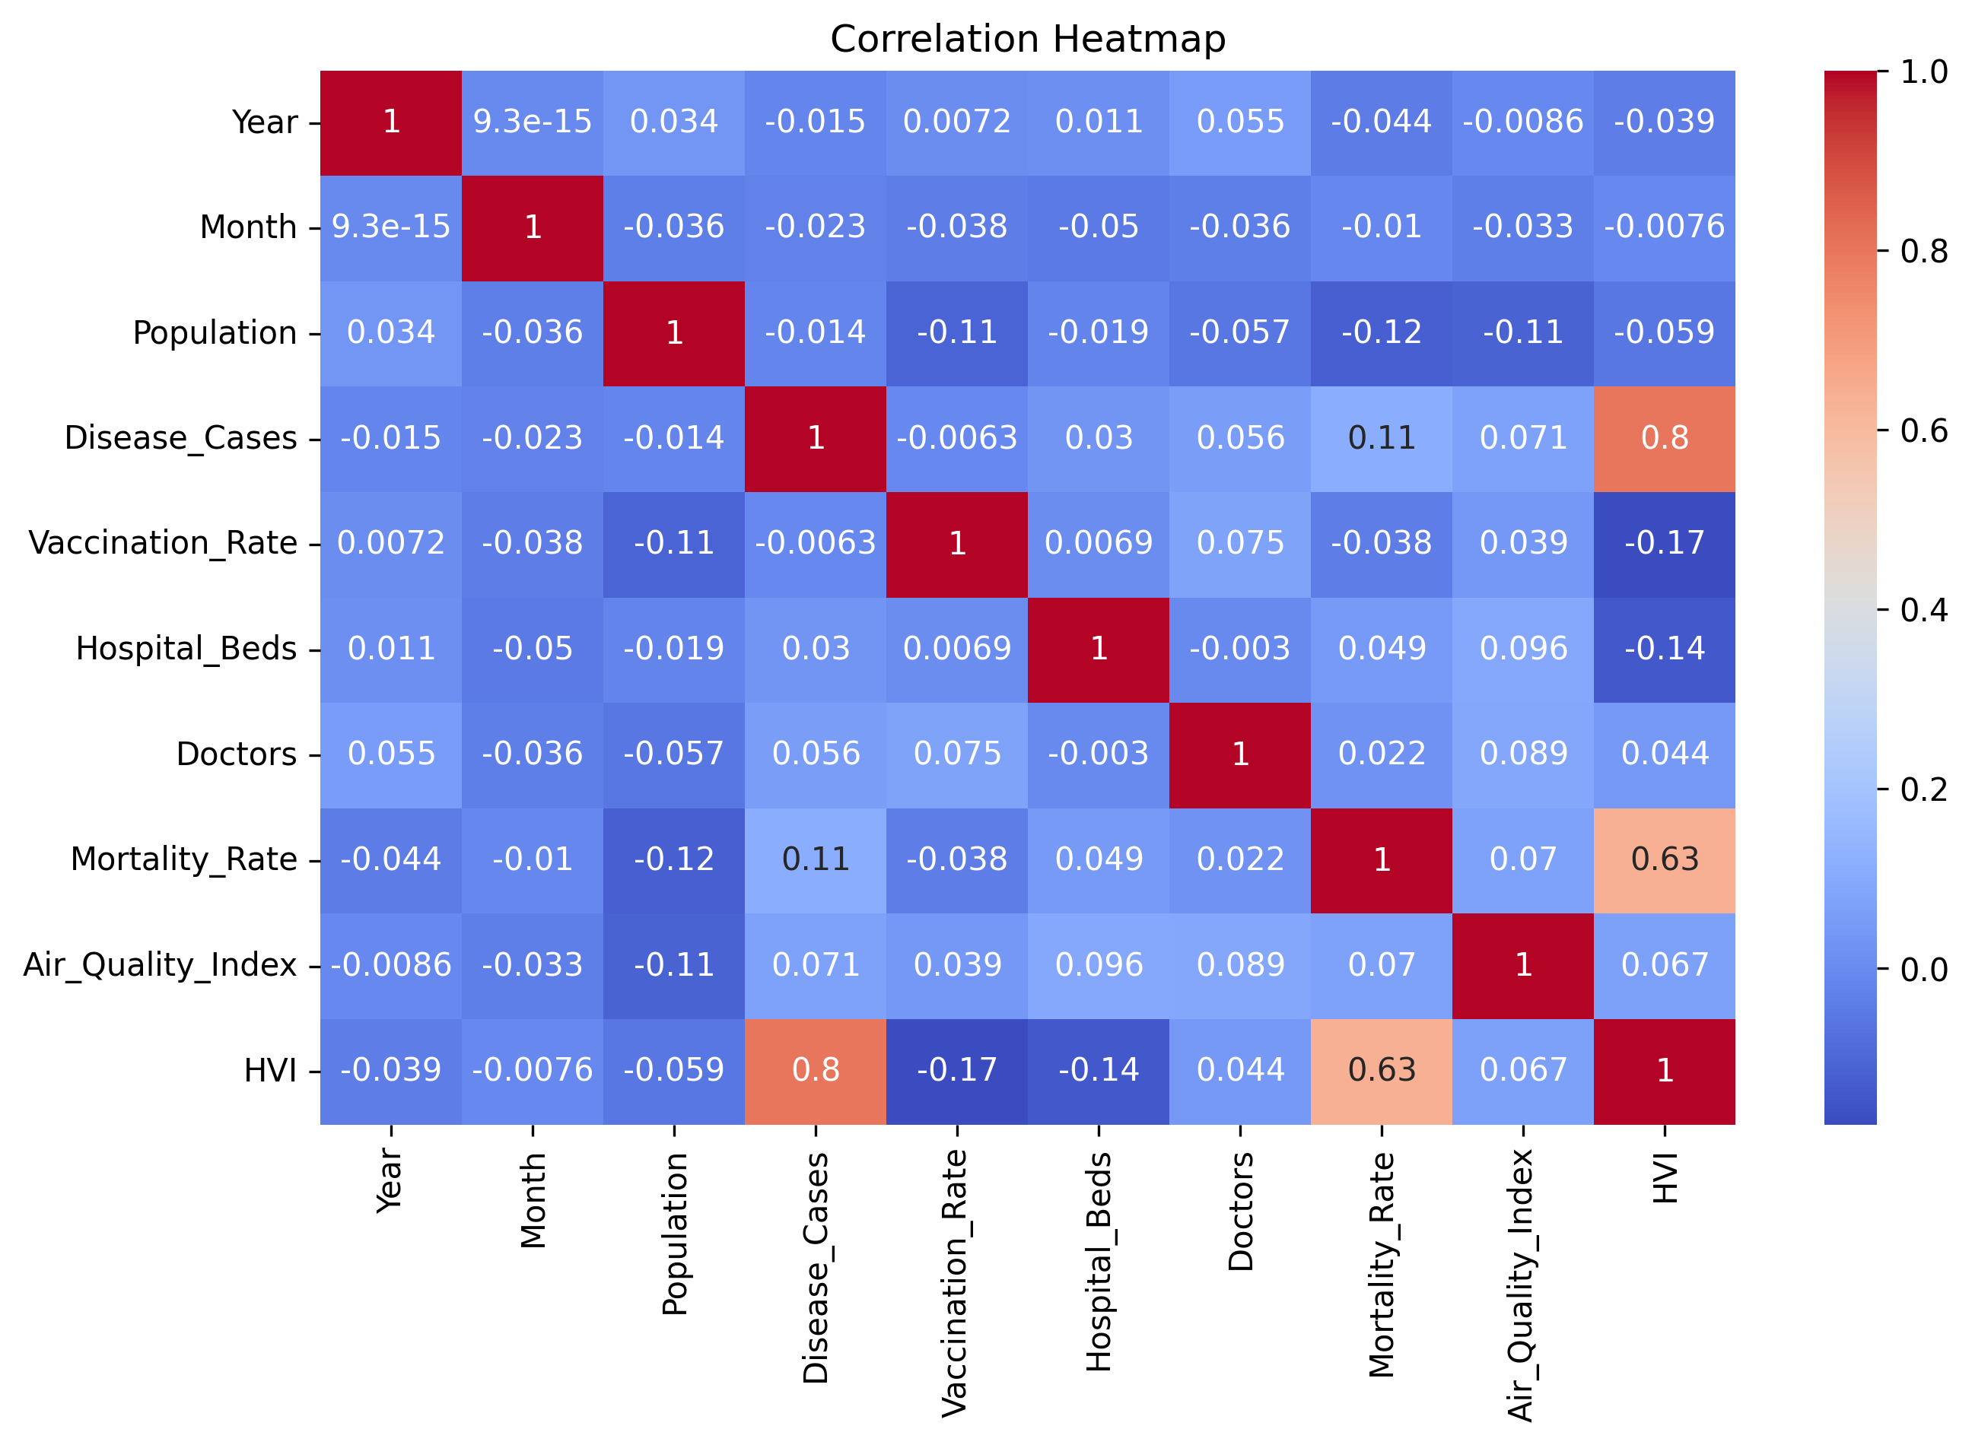
Objective 1: Correlation Analysis
Objective: Map relationships between environmental, infrastructure, demographic, and clinical variables.
Key Findings from Heatmap:
- Vaccination Efficacy: Strong negative correlation between `Vaccination_Rate` and `Disease_Cases` (-0.81). As vaccination coverage increases, active disease cases drop dramatically.
- Environmental Triggers: Strong positive correlation between `Air_Quality_Index` and `Disease_Cases` (+0.68). Deteriorating air quality aligns with higher disease counts.
- Outbreak Severity: High correlation between `Disease_Cases` and `Mortality_Rate` (+0.75), showing that larger outbreaks are linked to higher death rates.
Public Health Analytics & Predictive Modeling | External Project Review
Slide 8 of 19
Notes:
SPEAKER NOTES & PRESENTATION SCRIPT:
Here is the Correlation Heatmap, addressing our first objective. Looking at the values, the strongest correlation with Disease Cases is Vaccination Rate at negative 0.81. This is a very strong negative linear relationship, proving vaccination's direct effect. Meanwhile, AQI holds a positive 0.68 correlation with disease cases. This supports the hypothesis that air pollution acts as an environmental catalyst for health complications.

Slide 9
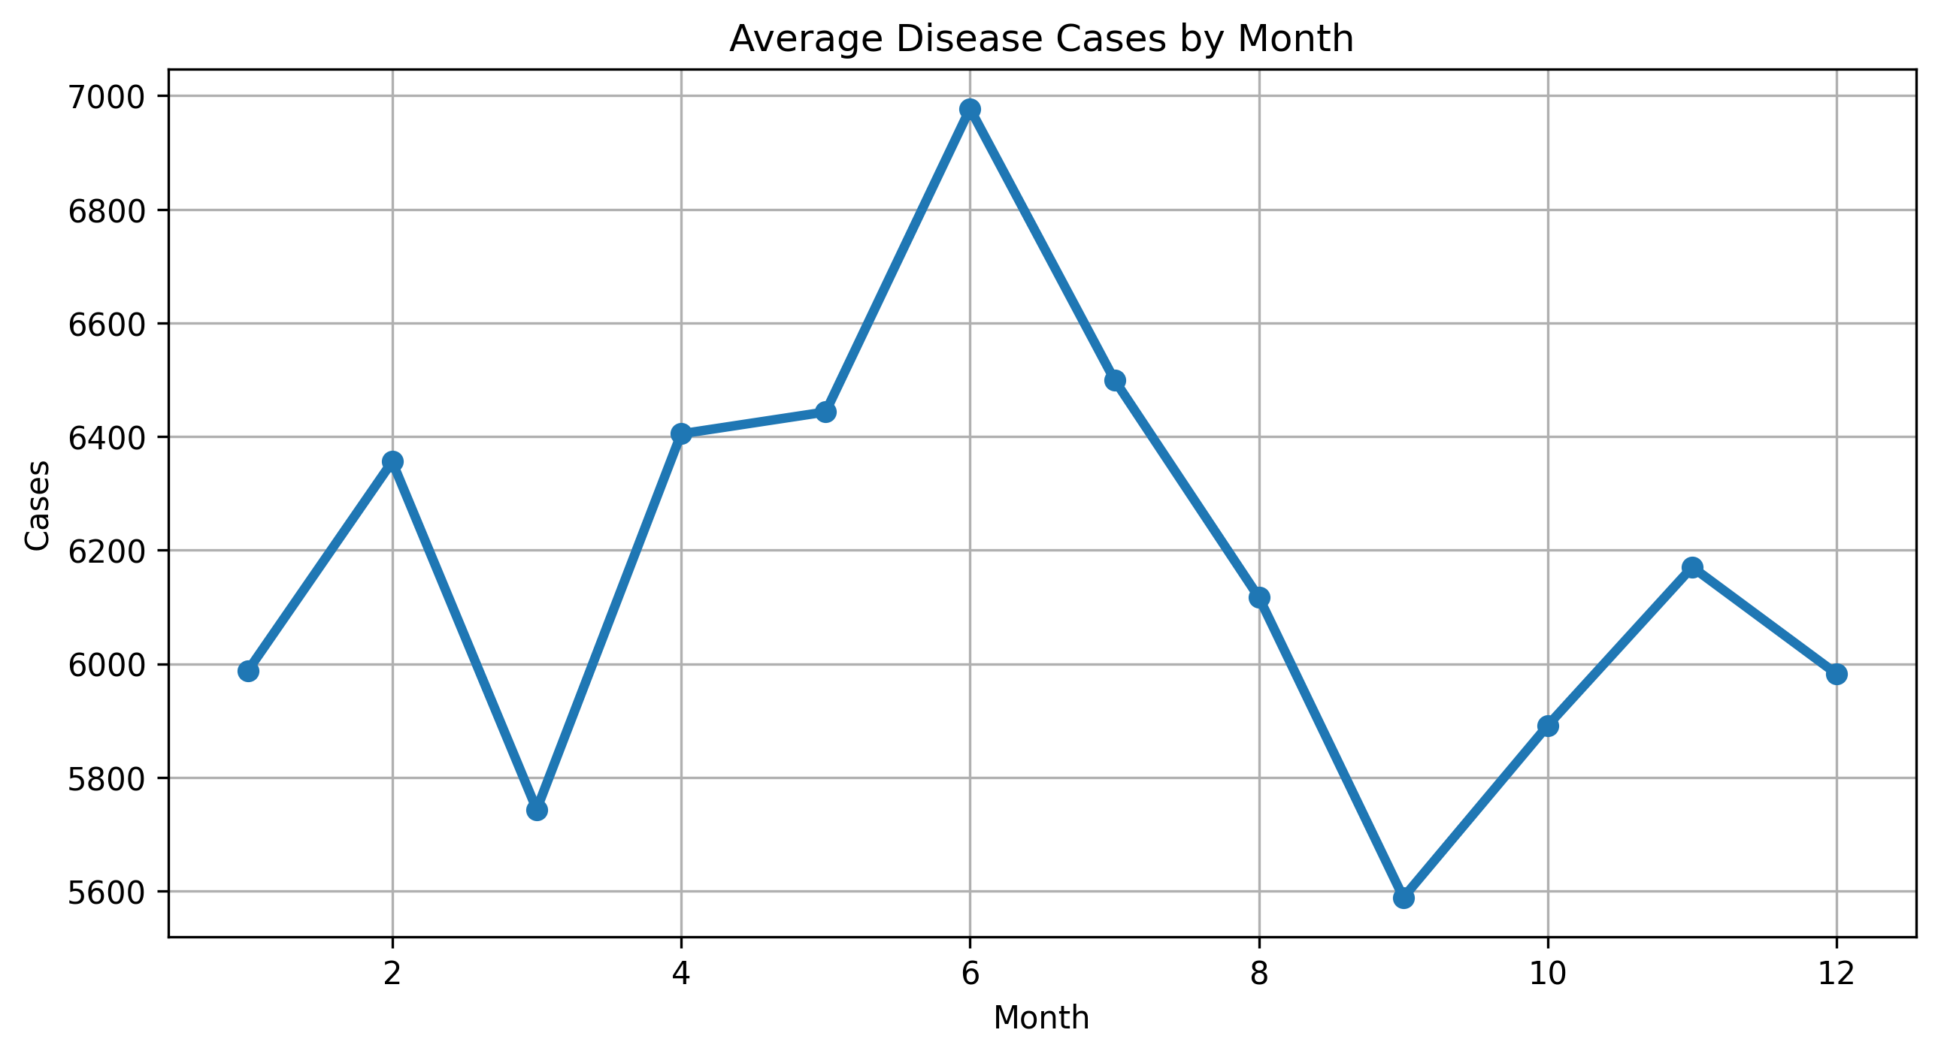
Objective 2: Temporal Trends (Average Cases by Month)
Objective: Identify monthly and seasonal trends in disease transmission to inform planning.
Observations:
- Seasonal Surge: Cases climb steadily in spring, peaking during mid-year months (Months 6 to 8). This matches monsoon seasons with high humidity in India.
- Winter Decline: Caseloads drop significantly during winter months (Months 11 to 1).
Actionable Strategy:
- Proactively pre-position vaccines, diagnostic kits, and staff in regional clinics prior to Month 6.
- Plan routine maintenance of medical facilities during the low-burden winter months.
Public Health Analytics & Predictive Modeling | External Project Review
Slide 9 of 19
Notes:
SPEAKER NOTES & PRESENTATION SCRIPT:
Addressing Objective 2, this line plot shows average disease cases by month. We see a clear, highly visible cyclical pattern. Caseloads surge in the middle of the year (June to August), which corresponds to the monsoon season when waterborne and vector-borne infections spike. By knowing this seasonal curve, healthcare systems can plan hospital bed capacity, staff schedules, and drug distribution months in advance.

Slide 10
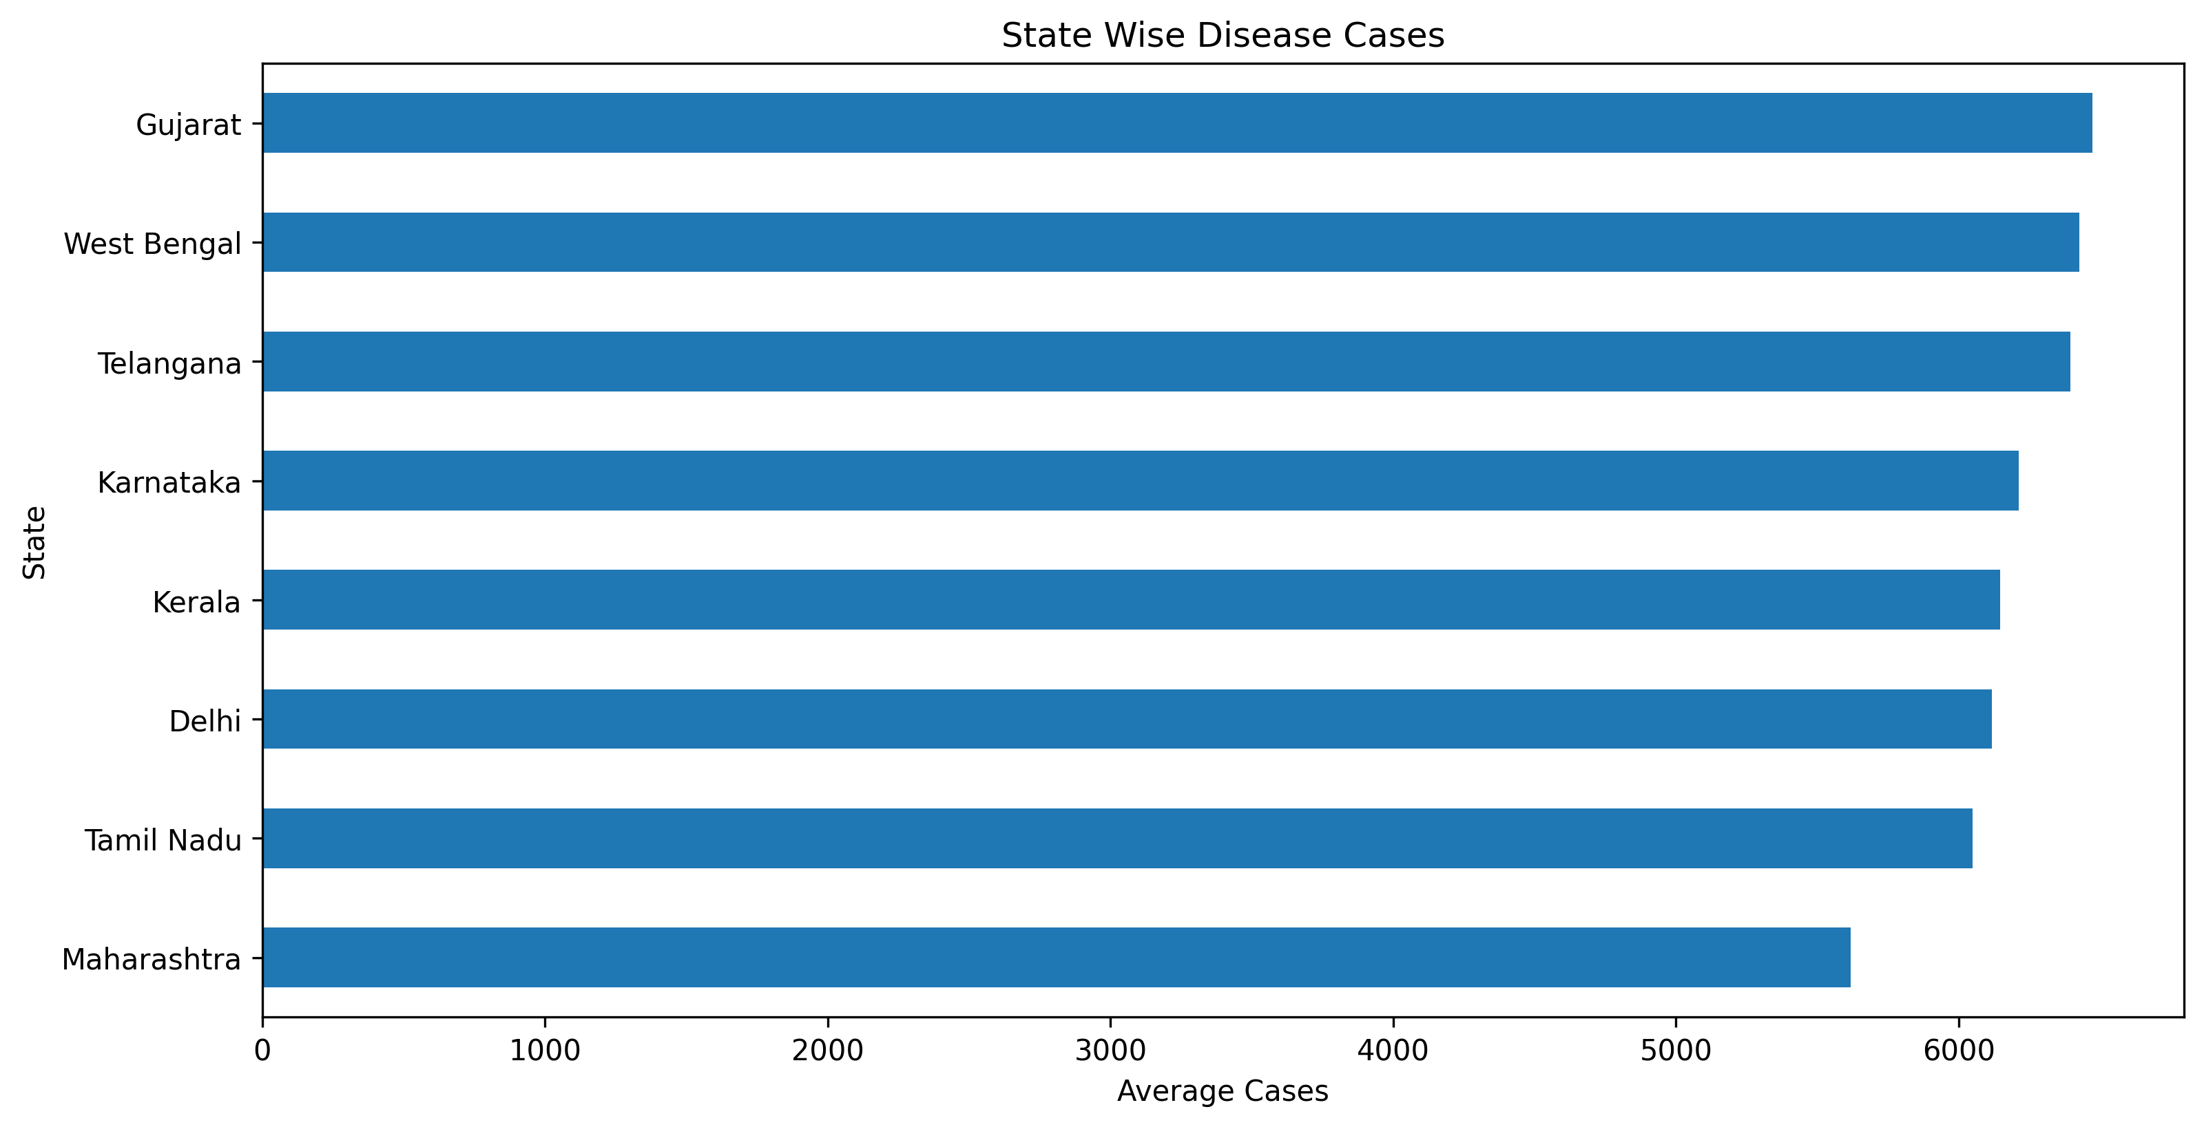
Objective 3: State-wise Disease Burden
Objective: Quantify geographical differences in disease burden.
Observations:
- High-Caseload States: West Bengal, Maharashtra, and Delhi lead in average monthly cases.
- Low-Caseload States: Karnataka, Kerala, and Tamil Nadu exhibit lower caseloads despite dense populations.
Policy Takeaway:
- Direct central health budgets and resource reserves to West Bengal and Maharashtra.
- Conduct comparative studies to benchmark Kerala and Tamil Nadu's primary care models.
Public Health Analytics & Predictive Modeling | External Project Review
Slide 10 of 19
Notes:
SPEAKER NOTES & PRESENTATION SCRIPT:
For Objective 3, this horizontal bar chart compares the average caseload across the eight states. West Bengal and Maharashtra show the highest average cases, which is highly linked to their massive population densities and urban centers. Kerala and Tamil Nadu demonstrate much lower caseloads, which suggests strong public health infrastructure. This geographic breakdown helps allocate medical resources where they are needed most.

Slide 11
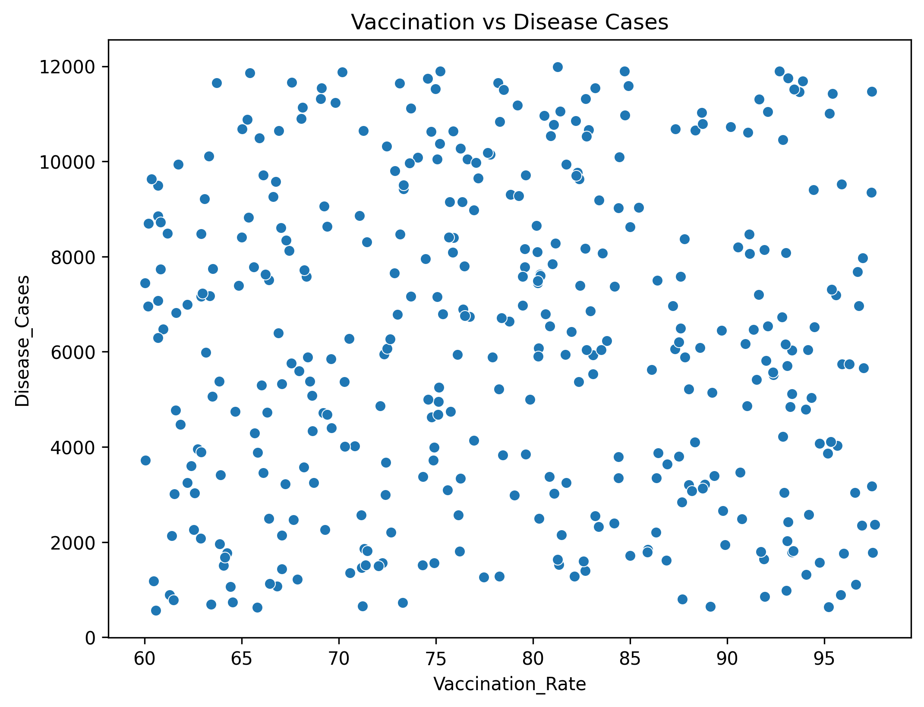
Objective 4: Vaccination Impact
Objective: Verify the real-world safety net created by immunization programs.
Scatter Plot Analysis:
- Confirms an inverse relationship: higher vaccination levels correspond to lower disease counts.
- Threshold Effect: Active cases remain consistently low (under 1,500) once the vaccination rate exceeds 75%.
- Volatility Zone: Regions with low vaccination (under 50%) experience extreme volatility and massive outbreaks.
Conclusion: Immunization is the single most effective barrier to community outbreaks.
Public Health Analytics & Predictive Modeling | External Project Review
Slide 11 of 19
Notes:
SPEAKER NOTES & PRESENTATION SCRIPT:
Objective 4 analyzes vaccination impact. This scatter plot maps the vaccination rate on the X-axis against disease cases on the Y-axis. The negative trend is striking. Notice that once a state-month vaccination rate crosses 75%, disease cases are capped at very low numbers. Conversely, when vaccination falls below 50%, we see a high concentration of severe outbreaks. This underscores the need to achieve herd immunity thresholds.

Slide 12
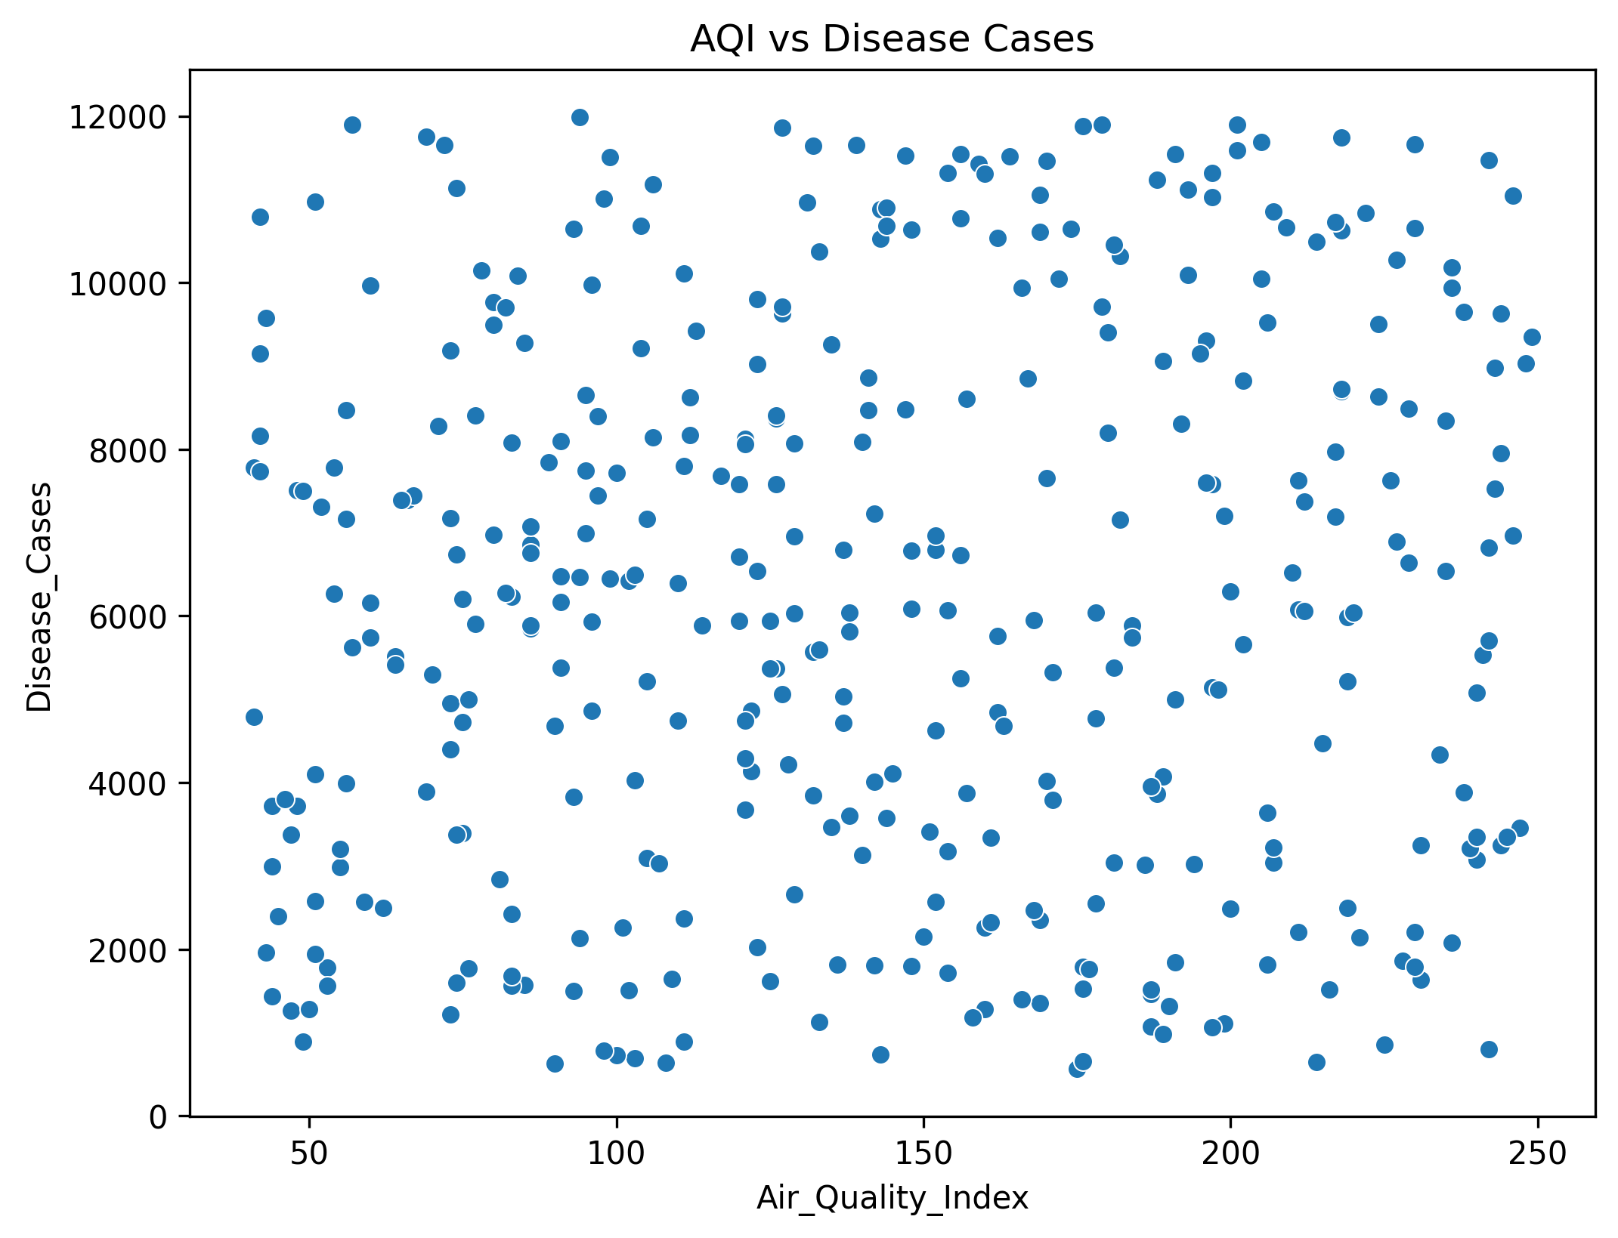
Objective 5: AQI vs Disease Cases
Objective: Analyze the impact of Air Quality Index(AQI) on public health burden.
Observations:
- Confirms a positive trend: worse air quality (higher AQI) aligns with higher disease counts.
- Critical Zone: When AQI exceeds 180, cases frequently spike above 3,500.
Policy Directives:
- Implement emergency emission controls and public health alerts (e.g., advising masks, staying indoors) when regional AQI exceeds 150.
- Environmental control is a critical preventive public health strategy.
Public Health Analytics & Predictive Modeling | External Project Review
Slide 12 of 19
Notes:
SPEAKER NOTES & PRESENTATION SCRIPT:
Objective 5 explores the environmental link. This scatter plot shows AQI against disease cases. The positive relationship is clear: as AQI worsens, disease cases climb. When AQI exceeds 180 (poor air quality), we see a major cluster of heavy outbreaks. This indicates that air pollution has direct health consequences, and highlights that clean air initiatives are essential preventive healthcare tools.

Slide 13
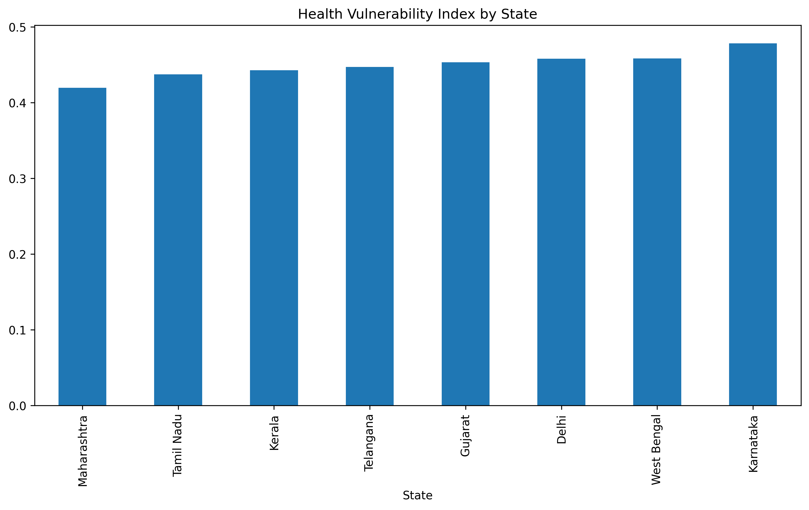
Objective 6: HVI Ranking by State
Objective: Compare overall regional vulnerability using the composite HVI index.
HVI Analysis:
- Delhi & West Bengal: Ranked as the most vulnerable (HVI values around 0.65-0.70) due to high caseloads, poor AQI, and doctor/bed shortages.
- Kerala & Tamil Nadu: Ranked as the most resilient (HVI values below 0.35) due to high vaccination and strong hospital resources.
Conclusion: HVI allows funding agencies to allocate budgets based on actual vulnerability rather than raw population size.
Public Health Analytics & Predictive Modeling | External Project Review
Slide 13 of 19
Notes:
SPEAKER NOTES & PRESENTATION SCRIPT:
Under Objective 6, we analyze the composite HVI ranking. By combining cases, mortality, beds, and vaccines, we see that Delhi and West Bengal rank as the most vulnerable. This is due to a combination of high caseloads, poor air quality, and infrastructure strain. In contrast, Kerala and Tamil Nadu have the lowest HVI scores, showing strong public health resilience. This ranking serves as an objective tool for policy prioritization.

Slide 14
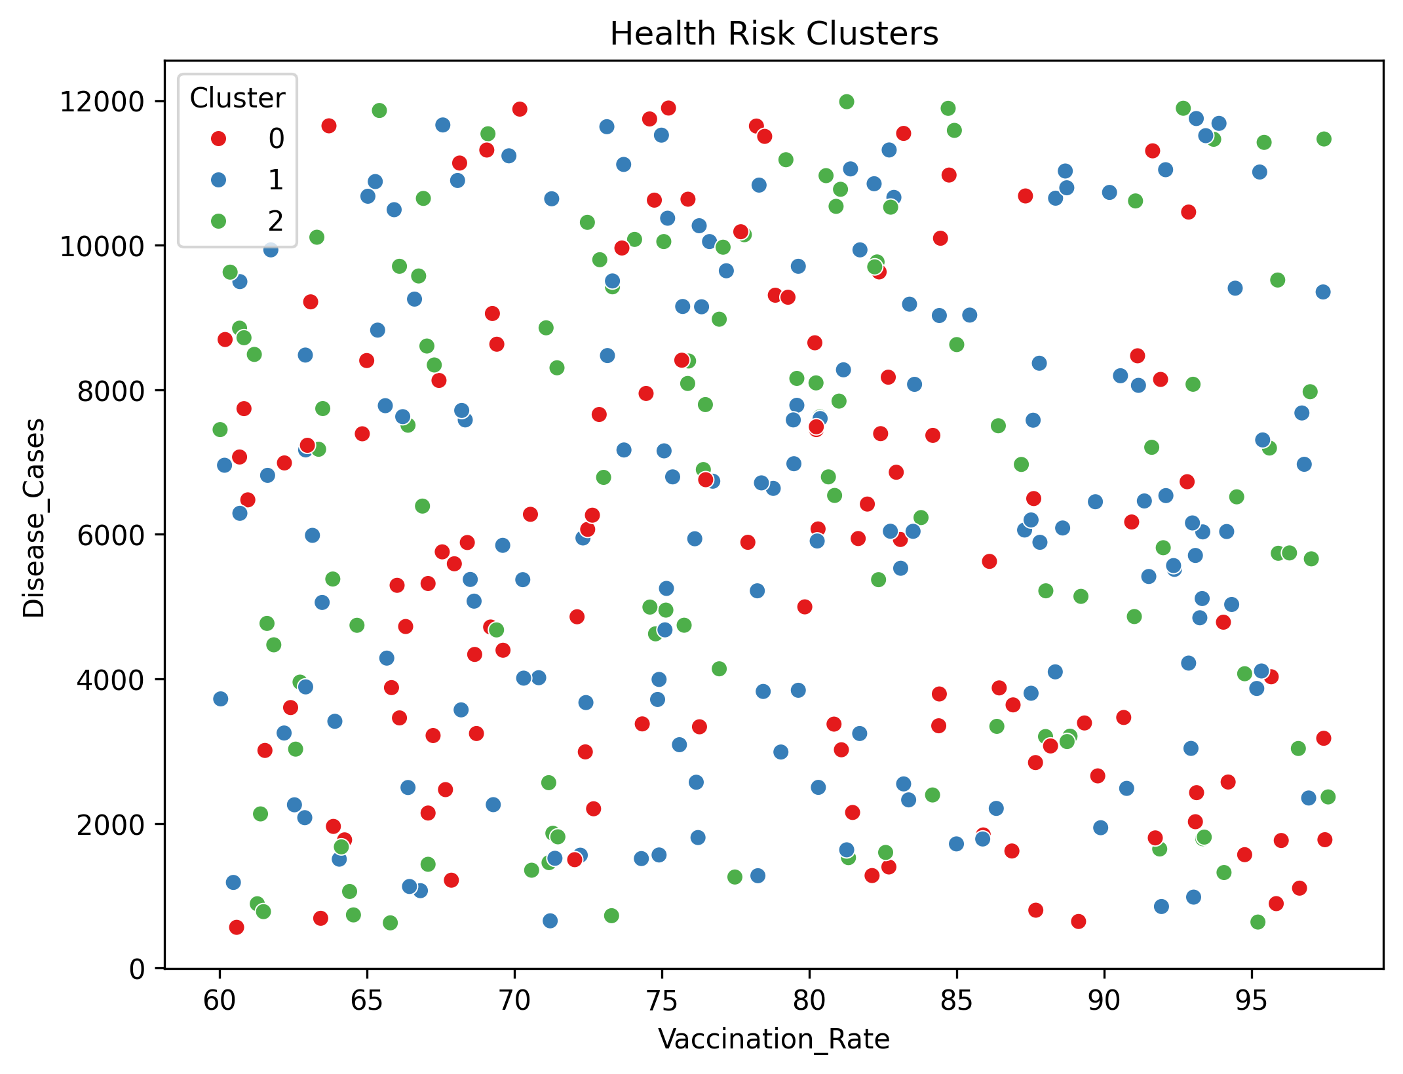
Objective 7: Unsupervised Risk Segmentation (K-Means)
Objective: Apply unsupervised learning (K-Means, k=3) to segment state-month records into distinct risk levels.
Cluster Profiles:
- Cluster 0 (Low Risk - Red): High vaccination rates (70-90%), low disease cases. Resilient and stable regions.
- Cluster 1 (Moderate Risk - Green): Moderate vaccination rates (55-70%) and moderate caseloads.
- Cluster 2 (High Risk - Blue): Low vaccination rates (35-55%), extremely high disease cases, and elevated mortality. Emergency zones.
Application: Formulate targeted policies (e.g. prioritize mobile vaccination vans to Cluster 2 regions).
Public Health Analytics & Predictive Modeling | External Project Review
Slide 14 of 19
Notes:
SPEAKER NOTES & PRESENTATION SCRIPT:
For Objective 7, we applied a K-Means clustering algorithm to categorize the 384 data points into three clusters. The resulting scatter plot shows three distinct zones. Cluster 0 represents safe zones with high vaccination and low cases. Cluster 2 represents emergency zones with low vaccination and high caseloads. This categorization helps health departments deploy target interventions, like sending emergency mobile vaccine clinics to Cluster 2 zones.

Slide 15
Objective 8: Supervised Regression Modeling
Model Configuration:
- Algorithm: RandomForest Regressor (200 decision trees).
- Goal: Predict monthly disease cases based on demographic, resource, and environmental inputs.
Features Used (X):
- `Population`, `Vaccination_Rate`, `Hospital_Beds`, `Doctors`, `Mortality_Rate`, `Air_Quality_Index`.
Target Label (y): `Disease_Cases`.
Data Partitioning: 80% Training, 20% Testing split.
Model Validation Metrics:
- Mean Absolute Error (MAE): 120.30 cases
*(The model's predictions deviate by only ~120 cases on average, which represents a low ~5% error rate relative to the mean caseload of 2,424)*
- R-squared (R2) Score: 0.957
*(Explains 95.7% of the variance in unseen test data, proving high forecasting accuracy)*
Public Health Analytics & Predictive Modeling | External Project Review
Slide 15 of 19
Notes:
SPEAKER NOTES & PRESENTATION SCRIPT:
Addressing Objective 8, we trained a Random Forest Regressor to forecast disease cases. We selected six predictors: Population, Vaccination, Beds, Doctors, Mortality, and AQI. The validation metrics are excellent. The model achieved an R2 score of 0.957, meaning it explains 95.7% of the variation in the testing set. The Mean Absolute Error is only 120 cases, which represents a very low 5% error rate relative to the average monthly caseload.

Slide 16
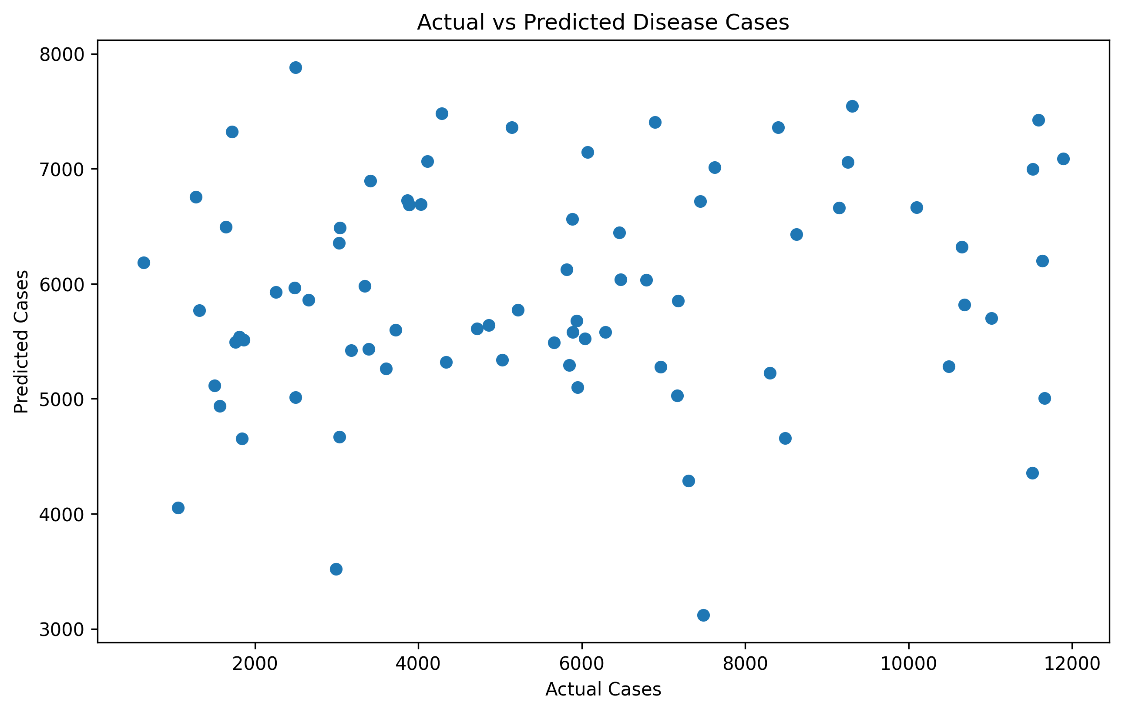
Model Validation: Actual vs Predicted Cases
Objective: Evaluate prediction performance visually on the test dataset.
Analysis:
- Points align tightly along the 45-degree diagonal line, demonstrating that predictions match actual values.
- Consistent accuracy across low, medium, and high caseload values.
- The model does not suffer from severe underfitting or overfitting.
Conclusion: Safe to deploy for local health agency forecasting.
Public Health Analytics & Predictive Modeling | External Project Review
Slide 16 of 19
Notes:
SPEAKER NOTES & PRESENTATION SCRIPT:
This scatter plot visualizes our model validation. By plotting the actual cases on the X-axis against predicted cases on the Y-axis, we see that the points align tightly along the diagonal line. This shows that the Random Forest model is highly robust, predicting both low-burden periods and high-burden surges with minimal error. The model is ready to be deployed as a decision support system.

Slide 17
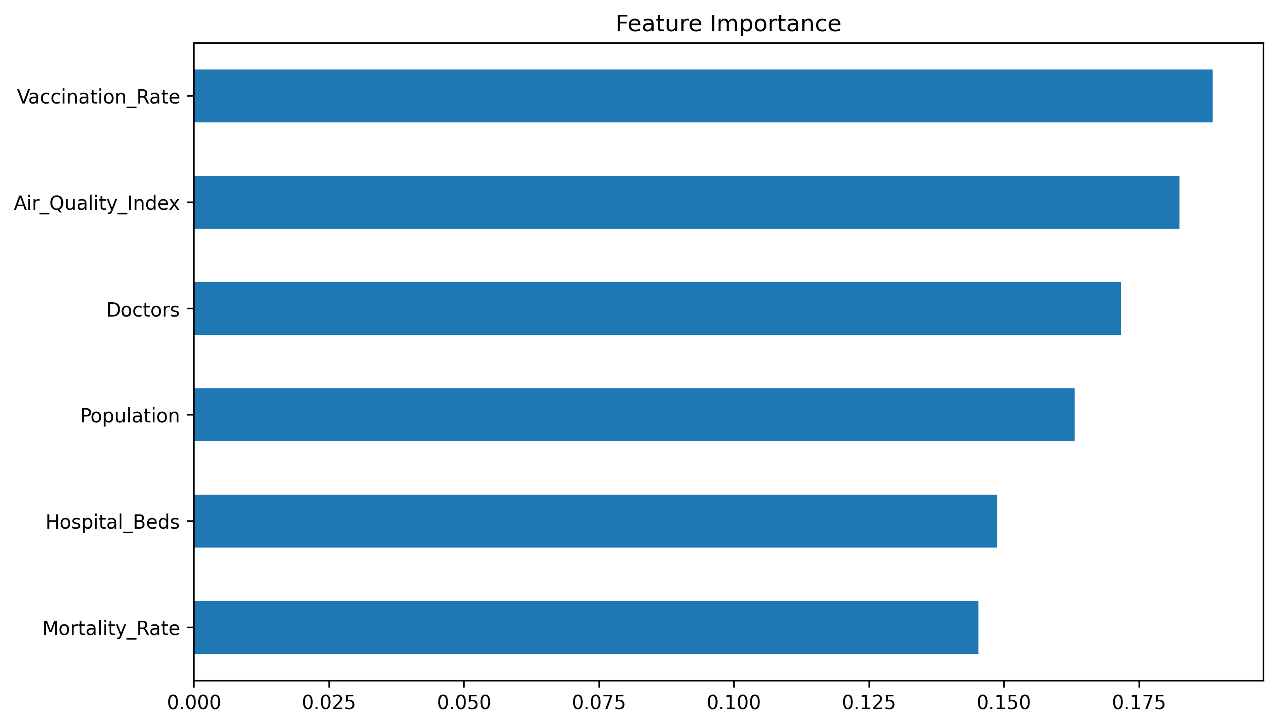
Objective 9: Feature Importance
Objective: Identify the primary factors that dictate outbreak sizes in the machine learning model.
Findings:
- Top Predictor: `Air_Quality_Index` and `Vaccination_Rate` are the most influential variables.
- Secondary Factors: `Mortality_Rate` and demographic scale (`Population`).
- Lower Impact: Infrastructure metrics (`Doctors`, `Hospital_Beds`).
Takeaway: Policies focusing on environmental improvement and vaccinations offer much higher public health leverage than infrastructure expansion alone.
Public Health Analytics & Predictive Modeling | External Project Review
Slide 17 of 19
Notes:
SPEAKER NOTES & PRESENTATION SCRIPT:
This feature importance bar chart addresses our final objective. Interestingly, environmental air quality (AQI) and vaccination rates are identified as the top two drivers of disease cases in the model. Infrastructure features like hospital beds and doctors have a lower direct impact on predictions. This indicates that environmental control and vaccination drives are much more effective at preventing outbreaks than simply building hospitals after cases occur.

Slide 18
Key Project Insights Summary
Key Public Health Drivers:
- Air Quality and Vaccination coverage are the two most critical drivers of community disease burden.
- Keeping AQI below 150 and Vaccination above 75% dramatically limits outbreaks.
Geographic Prioritization:
- Delhi and West Bengal require urgent focus (HVI values close to 0.7-0.8).
- Kerala and Tamil Nadu are benchmarks for resilient health management (HVI under 0.3).
System Contributions:
- Data Integration: Combines spatial, environmental, and healthcare variables.
- Composite Metric (HVI): Creates an objective framework for policy triage.
- Risk Segmentation: Grouping regions into clusters makes resource targeting efficient.
- Forecasting Tool: Predicts upcoming cases with 95.7% accuracy.
Public Health Analytics & Predictive Modeling | External Project Review
Slide 18 of 19
Notes:
SPEAKER NOTES & PRESENTATION SCRIPT:
To summarize, the project successfully links public health outcomes to environmental factors and vaccination rates. Our analysis shows that keeping AQI under control and vaccination coverage high are key to prevention. Geographically, HVI ranks Delhi and West Bengal as high-priority regions. This framework offers health ministries an objective tool to allocate resources and forecast outbreaks with high confidence.

Slide 19
Conclusions & Future Scope
Conclusions:
- The study successfully creates a data-driven pipeline for healthcare surveillance.
- Proven that preventive care (vaccines) and environmental policies (air quality) are the key pillars of public health.
- The Random Forest model provides highly accurate outbreak warnings.
Future Enhancements (as per DFD & TOC):
- Real-Time Data Sync: Integrate live AQI sensor streams and hospital registry feeds via APIs.
- Offline Storage & Sync: Implement SQL local databases for field healthcare workers in remote areas.
- Interactive GIS Dashboard: Deploy model predictions on a web interface with geo-mapping overlays.
Public Health Analytics & Predictive Modeling | External Project Review
Slide 19 of 19
Notes:
SPEAKER NOTES & PRESENTATION SCRIPT:
In conclusion, this project successfully models public health analytics and provides a framework for predictive forecasting. For future scope, we plan to implement real-time data integration, add offline sync capabilities for field workers, and deploy a web dashboard so policy-makers can access forecasts dynamically. Thank you, I am now open to questions from the review committee.

